Slide 1

Cognitive Analytics
By: Chandana MN
VINAY R
GALI LAKSHMI VENKATA MAHESH
ASSIGNED BY- DR. Punam Kumari

Slide 2

EM Algorithm

Slide 3
EM Algorithm
The EM algorithm, short for Expectation-Maximization algorithm.
It is an iterative method used in statistics and machine learning to estimate the parameters of a statistical model when there are missing or incomplete data.
It is defined as the combination of various unsupervised machine learning algorithms, which is used to determine the local maximum likelihood estimates (MLE) or maximum a posteriori estimates (MAP) for unobservable variables in statistical models.

Slide 4
Some Key points on EM Algorithm:
It is known as the latent variable model to determine MLE and MAP parameters for latent variables.
It is used to predict values of parameters in instances where data is missing or unobservable for learning, and this is done until convergence of the values occurs.
The EM algorithm is the combination of various unsupervised ML algorithms, such as the k-means clustering algorithm.

Slide 5
EM algorithm MODELS:
IEM algorithm is an iterative approach, it consists of two modes.
In the first mode, we estimate the missing or latent variables. Hence it is referred to as the Expectation/estimation step (E-step).
The other mode is used to optimize the parameters of the models so that it can explain the data more clearly. The second mode is known as the maximization-step or M-step.

Slide 6
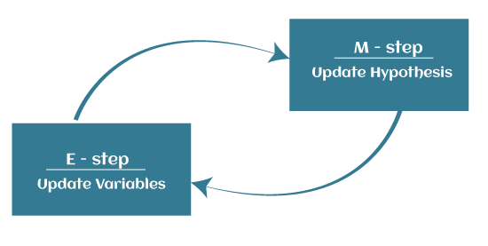
Steps in em algorithm:
Expectation step (E - step): It involves the estimation (guess) of all missing values in the dataset so that after completing this step, there should not be any missing value.
Maximization step (M - step): This step involves the use of estimated data in the E-step and updating the parameters.
Repeat E-step and M-step until the convergence of the values occurs.
NOTE: The primary goal of the EM algorithm is to use the available observed data of the dataset to estimate the missing data of the latent variables and then use that data to update the values of the parameters in the M-step.

Slide 7
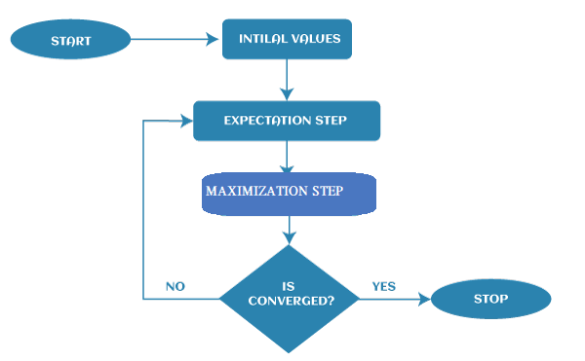
Flow chart of EM Algorithm:

Slide 8
Applications of EM algorithm
The EM algorithm is applicable in data clustering in machine learning.
It is often used in computer vision and NLP (Natural language processing).
It is used to estimate the value of the parameter in mixed models such as the Gaussian Mixture Model and quantitative genetics.
It is also used in psychometrics for estimating item parameters and latent abilities of item response theory models.
It is also applicable in the medical and healthcare industry, such as in image reconstruction and structural engineering.
It is used to determine the Gaussian density of a function.

Slide 9
Advantages of EM algorithm
It is very easy to implement the first two basic steps of the EM algorithm in various machine learning problems, which are E-step and M- step.
It is mostly guaranteed that likelihood will enhance after each iteration.
It often generates a solution for the M-step in the closed form.

Slide 10
Disadvantages of EM algorithm
The convergence of the EM algorithm is very slow.
It can make convergence for the local optima only.
It takes both forward and backward probability into consideration. It is opposite to that of numerical optimization, which takes only forward probabilities.

Slide 11

Thank you......!!!!!!

